Slide 1
Evolution of Angular
Angular is a JavaScript-based open-source framework for building client-side web applications. So, let us first understand Javascript.
JavaScript runs on the client-side of the web, which can be used to design or program how the web pages behave on the occurrence of an event.
Typically, JavaScript is used for interface interactions, slideshows, and other interactive components.
JavaScript evolved quickly and has also been used for server-side programming (like in Node.js), game development, etc.
JavaScript deals with dynamic content, which is an important aspect of web development. Dynamic content refers to constantly changing content and it adapts to specific users.
For example, JavaScript can be used to determine whether or not to render the mobile version of the website by checking the device, which is accessing the website.
This encouraged web developers to start creating their own custom JavaScript libraries for reducing the number of code lines and implementing complex functionalities easily.
jQuery is a fast, small, and feature-rich JavaScript library, which makes things like HTML document traversal and manipulation, event handling, animation, and Ajax much simpler with an easy-to-use API.

Slide 2
Evolution of Angular (Continued)
jQuery became the most popular one because it was easy to use and extremely powerful.
Since jQuery has no real structure, the developer has full freedom to build projects as they see fit.
However, the lack of structure also means it’s easier to fall into the trap of “spaghetti code,” which can lead to confusion in larger projects with no clear design direction or code maintainability.
For these situations, a framework like Angular can be a big help.

Slide 3
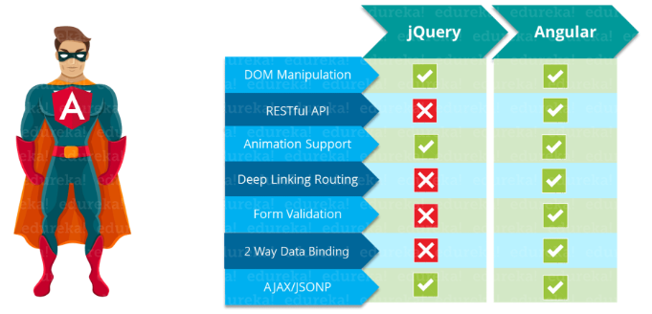
Comparison between jQuery and Angular

Slide 4
Building Blocks of Angular
The main building blocks of Angular are:
Modules
Components
Templates
Metadata
Data binding
Directives
Services
Dependency injection

Slide 5
Modules
Modules are a great way to organize an application and extend it with capabilities from external libraries.
Angular libraries are NgModules, such as FormsModule, HttpClientModule and RouterModule. Many third-party libraries are available as NgModules such as Material Design, Ionic, and AngularFire2.
NgModules consolidate components, directives, and pipes into cohesive blocks of functionality, each focused on a feature area, application business domain, workflow, or common collection of utilities.
Modules can also add services to the application. Such services might be internally developed, like something you'd develop yourself or come from outside sources, such as the Angular router and HTTP client.
Modules can be loaded eagerly when the application starts or lazy loaded asynchronously by the router.
Every Angular app has at least one module, the root module. You bootstrap that module to launch the application.
Decorators are functions that modify JavaScript classes. Decorators are basically used for attaching metadata to classes so that, it knows the configuration of those classes and how they should work. NgModule is a decorator function that takes metadata objects whose properties describe the module. We will talk more about Decorators at the end of this presentation.

Slide 6
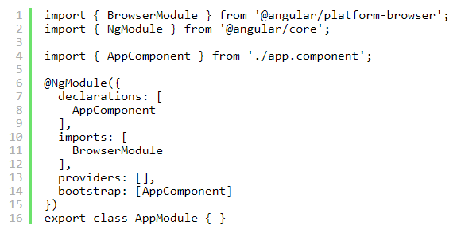
Modules (continued)
The properties are:
declarations: The classes that are related to views and they belong to this module. There are three classes of Angular that can contain view: components, directives, and pipes. We will talk about them in a while.
exports: The classes that should be accessible to the components of other modules.
imports: Modules whose classes are needed by the component of this module.
providers: Services present in one of the modules which are to be used in the other modules or components. Once a service is included in the providers it becomes accessible in all parts of that application
bootstrap: The root component which is the main view of the application. This root module only has this property and it indicates the component that is to be bootstrapped.

Slide 7
Modules (continued)
Angular libraries
Angular gives us a collection of JavaScript modules (library modules) that provide various functionalities.
Each Angular library has @angular prefix, like @angular/core, @angular/compiler, @angular/compiler-cli, @angular/http, @angular/router.
We can install them using the npm package manager and import parts of them with JavaScript import statements.
In the above example, Angular’s NgModule decorator is imported from the @angular/core library.

Slide 8
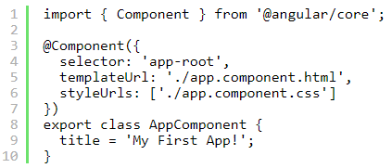
Components
A component controls one or more sections on the screen called a view.
For example, if you are building a course list application, you can have components like App Component (the bootstrapped component), Course Component, Course Detail Component, etc.
Inside the component, you define a component’s application logic i.e. how does it support the view—inside a class. The class interacts with the view through an API of properties and methods.
Every app has a main component that is bootstrapped inside the main module, i.e AppComponent.

Slide 9
Components (continued)
The properties are:
selector: which targets the keyword and dumps the data within the selected tag.
template/templateUrl: we can attach the view using two ways: either you can attach template property and specify the template here or we can use templateUrl and provide the path of the file which contains the template.
styleUrls: which gives the path of the CSS style sheet.

Slide 10
Templates
We associate the component’s view with its companion template.
A template is nothing but a form of HTML tags that tells Angular about how to render the component.
A template looks like regular HTML, except for a few differences.

Slide 11

Metadata
Metadata tells Angular how to process a class. To tell Angular that any Component is a component, metadata is attached to the class. In TypeScript, we attach metadata by using a decorator. In the below code, you can see metadata attached to the Course Component:
Here is the @Component decorator, which identifies the class immediately below it as a component class. The @Component decorator takes the required configuration object which Angular needs to create and present the component and its view.
The most important configurations of @Component decorator are:
selector: Selector tells Angular to create and insert an instance of this component where it finds <app-course> tag. For example, if an app’s HTML contains <app-course></app-course>, then Angular inserts an instance of the CourseComponent view between those tags.
templateUrl: It contains the path of this component’s HTML template.
styleUrls: It is the component-specific style sheet.
The metadata in the @Component tells Angular where to get the major building blocks you specify for the component. The template, metadata, and component together describe a view. The architectural takeaway is that you must add metadata to your code so that Angular knows what to do.

Slide 12
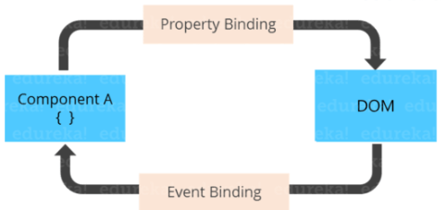
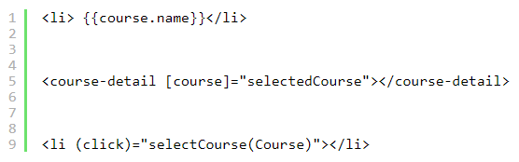
Data Binding
If we are not using a framework, we have to push data values into the HTML controls and turn user responses into some actions and value updates. Writing such push/pull logic is tedious, error-prone, and a nightmare to read.
Angular supports data binding, a mechanism for coordinating parts of a template with parts of a component. We should add binding markup to the template HTML to tell Angular how to connect both sides.
Each form has a direction — to the DOM, from the DOM, or in both directions.

Slide 13
Data Binding (continued)
Each form has a direction — to the DOM, from the DOM, or in both directions.
The {{course.name}} interpolation displays the component’s name property value within the <li> element.
The [course] property binding passes the value of selectedCourse from the CourseComponent to the course property of the child CourseDetailComponent.
The(click) event binding calls the component’s selectCourse method when the user clicks a courses’ name.

Slide 14
Data Binding - Two-way data binding
Two-way data binding is an important part as it combines property and event binding in a single notation, using the ngModel directive. Here’s an example from the CourseDetailComponent template:
In two-way binding, a data property value flows to the input box from the component as with property binding. The user’s changes also flow back to the component, resetting the property to the latest value, as with event binding.
Angular processes all data bindings once per JavaScript event cycle, from the root of the application component tree through all child components.
Data binding plays an important role in communication between a template and its component. Data binding is also important for communication between parent and child components.

Slide 15

Directives
Angular templates are dynamic. When Angular renders them, it transforms the DOM according to the instructions given by directives. A directive is a class with a @Directive decorator. A component is a directive-with-a-template; a @Component decorator is actually a @Directive decorator extended with template-oriented features.
While a component is technically a directive, components are so distinctive and central to Angular applications that this architectural overview separates components from directives.
Two other kinds of directives exist: structural and attribute directives.
Directive tends to appear within an element tag as attributes do, sometimes by name but more often as the target of an assignment or a binding.
Structural directives alter layout by adding, removing, and replacing elements in DOM.
This example template uses two built-in structural directives:
*ngFor tells Angular to retrieve one <li> per course in the courses
*ngIf includes the CourseDetail component only if a selected course exists.

Slide 16
Directives (continued)
Attribute directives alter the appearance or behavior of an existing element. In templates, they look like regular HTML attributes. The ngModel directive, which implements two-way data binding, is an example of an attribute directive. ngModel modifies the behavior of an existing element by setting its display value property and responding to change events.
Angular has a few more directives that either alter the layout structure (for example, ngSwitch) or modify aspects of DOM elements and components (for example, ngStyle and ngClass).
We can also write your own directives, i.e. Custom Directive.

Slide 17
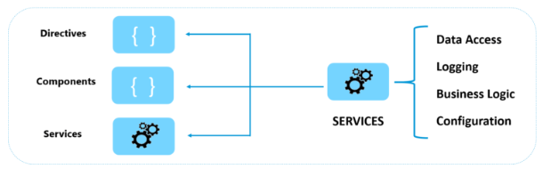
Services
Service is a broad category encompassing any value, function, or feature that your application needs. A service is typically a class with a well-defined purpose. Anything can be a service. Examples include:
logging service
data service
message bus
tax calculator
application configuration
Angular has no definition of a service. There is no service base class and no place to register a service. Yet services are fundamental to any Angular application. Components are the consumers of services.
Services are everywhere. Component classes don’t fetch data from the server, validate user input, or log directly to the console. They delegate such tasks to services.
A component’s job is to enable the user experience and nothing more. It mediates between the view (rendered by the template) and the application logic. A good component presents properties and methods for data binding. Angular does help you follow these principles by making it easy to factor your application logic into services and make those services available to components through dependency injection.

Slide 18
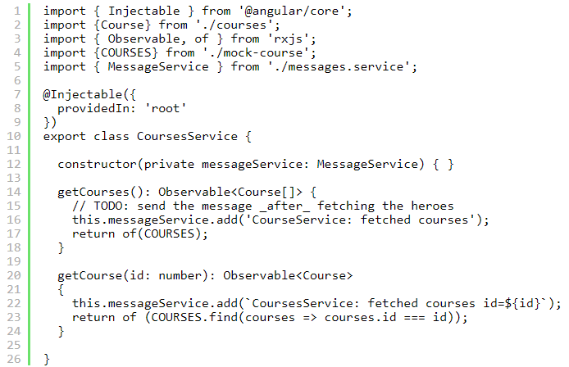
Services (continued)
Here’s an example of a service class:

Slide 19
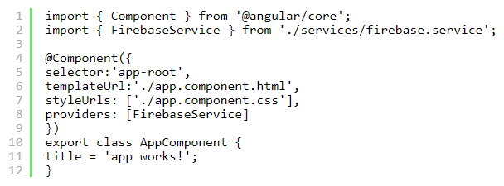
Dependency Injection
Dependency injection is a way to supply a new instance of a class with the fully-formed dependencies it requires. Most dependencies are services. Angular uses dependency injection to provide new components with the services they need. Angular can tell which services a component needs by looking at the types of its constructor parameters.
When Angular creates a component, it first asks an injector for the services that the component requires.
In the below example you can see, we are registering a provider of the Firebase Service with the injector.
In general, add providers to the root module so that the same instance of a service is available everywhere as shown in the code below.

Slide 20
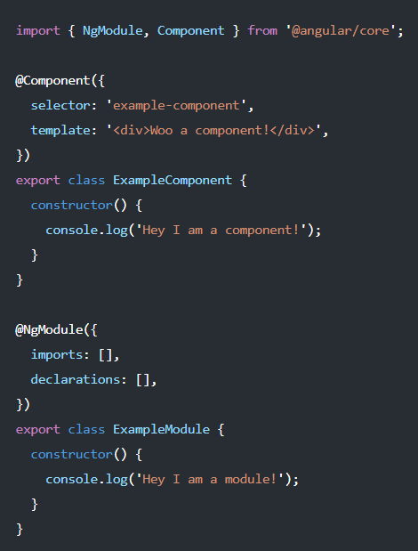
Decorators
There are four main types:
Class decorators, e.g. @Component and @NgModule
Property decorators for properties inside classes, e.g. @Input and @Output
Method decorators for methods inside classes, e.g. @HostListener
Parameter decorators for parameters inside class constructors, e.g. @Inject
Class Decorators
Angular offers us a few class decorators. These are the top-level decorators that we use to express intent for classes. They allow us to tell Angular that a particular class is a component, or module, for example. And the decorator allows us to define this intent without having to actually put any code inside the class.
A @Component and @NgModule decorator example with classes:
Notice how both classes by themselves are effectively the same. No code is needed within the class to tell Angular that it is a component or a module. All we need to do is decorate it, and Angular will do the rest.

Slide 21
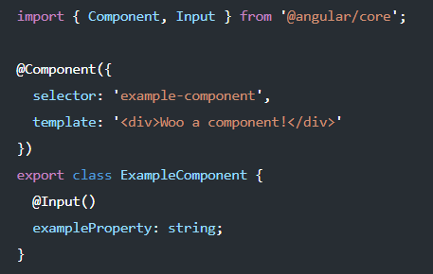
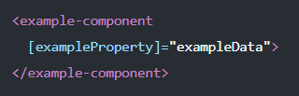
Decorators (continued)
Property Decorators
These are probably the second most common decorators that you’ll come across. They allow us to decorate specific properties within our classes - an extremely powerful mechanism.
Let’s take a look at @Input(). Imagine that we have a property within our class that we want to be an input binding.
Without decorators, we’d have to define this property in our class anyway for TypeScript to know about it, and then somewhere else tell Angular that we’ve got a property that we want to be an input.
With decorators, we can simply put the @Input() decorator above the property - which Angular’s compiler will automatically create an input binding from the property name and link them.

Slide 22
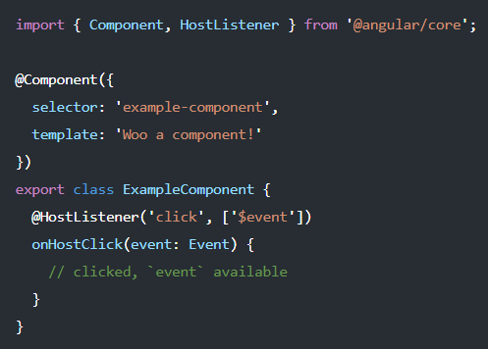
Decorators (continued)
Method Decorators
Method decorators are very similar to property decorators but are used for methods instead. This let’s us decorate specific methods within our class with functionality. A good example of this is @HostListener.
This allows us to tell Angular that when an event on our host happens, we want the decorated method to be called with the event.

Slide 23
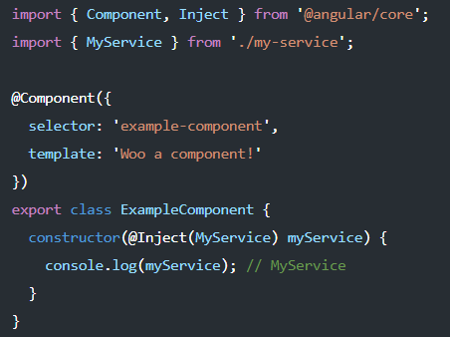
Decorators (continued)
Parameter Decorators
Parameter decorators are quite interesting. You may have come across these when injecting primitives into a constructor, where you need to manually tell Angular to inject a particular provider.
Parameter decorators allow us to decorate parameters in our class constructors. An example of this is @Inject that lets us tell Angular what we want that parameter to be initiated with:

Slide 24
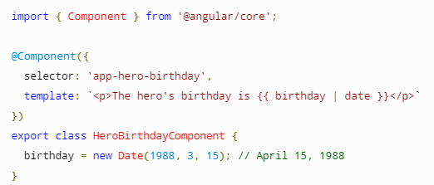
Pipes
A pipe takes in data as input and transforms it to a desired output.
List of built-in pipes:
CurrencyPipe
DatePipe
DecimalPipe
JsonPipe
KeyValuePipe
LowerCasePipe
PercentPipe
SlicePipe
TitleCasePipe
UpperCasePipe

Slide 25
Pipes (continued)
CurrencyPipe : Transforms a number to a currency string, formatted according to locale rules that determine group sizing and separator, decimal-point character, and other locale-specific configurations.(The default currency code is USD)
{{ value_expression | currency [ : currencyCode [ : display [ : digitsInfo [ : locale ] ] ] ] }}
DatePipe : Formats a date value according to locale rules.
{{ value_expression | date [ : format [ : timezone [ : locale ] ] ] }}
DecimalPipe : Transforms a number into a string, formatted according to locale rules that determine group sizing and separator, decimal-point character, and other locale-specific configurations.
{{ value_expression | number [ : digitsInfo [ : locale ] ] }}
JsonPipe : Converts a value into its JSON-format representation. Useful for debugging.
{{ value_expression | json }}
KeyValuePipe : Transforms Object or Map into an array of key value pairs.
{{ input_expression | keyvalue [ : compareFn ] }}

Slide 26
Pipes (continued)
LowerCasePipe : Transforms text to all lower case.
{{ value_expression | lowercase }}
PercentPipe : Transforms a number to a percentage string, formatted according to locale rules that determine group sizing and separator, decimal-point character, and other locale-specific configurations.
{{ value_expression | percent [ : digitsInfo [ : locale ] ] }}
SlicePipe : Creates a new Array or String containing a subset (slice) of the elements.
{{ value_expression | slice : start [ : end ] }}
TitleCasePipe : Transforms text to title case. Capitalizes the first letter of each word, and transforms the rest of the word to lower case. Words are delimited by any whitespace character, such as a space, tab, or line-feed character.
{ { value_expression | titlecase }}
UpperCasePipe : Transforms text to all upper case.
{{ value_expression | uppercase }}

